Slide 1
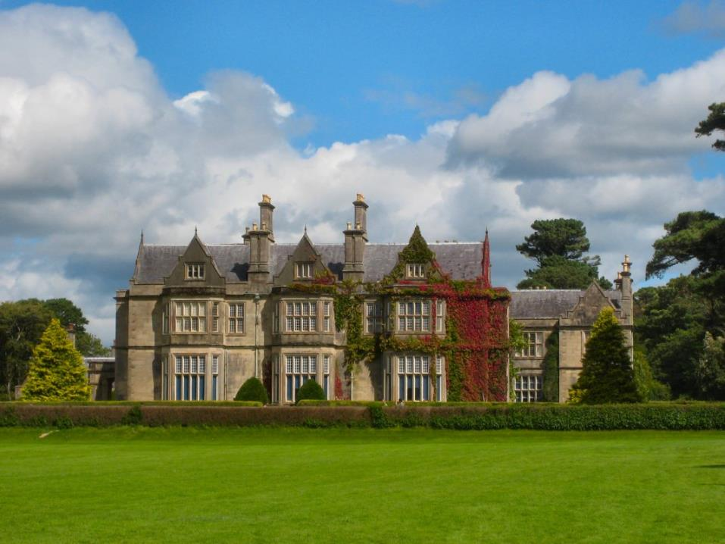
Muckross House, Killarney

Slide 2
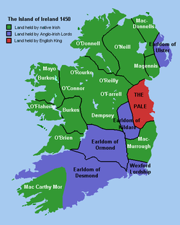
Queen Elizabeth of England (1533 -1603) was crowned in 1558 and reigned for 45 years.
The Queen feared that King Philip of Spain, would send an army to Ireland to attack England.
Much of Munster was ruled by the Fitzgerald family led by Gerald, Earl of Desmond.
At first the Earl was friendly with the Queen but he joined a rebellion against English rule in 1579.
Point 2
Queen Elizabeth was the daughter of the
Tudor King Henry VIII and his second wife
Anne Boleyn.

Slide 3
The Desmond Rebellion against the English crown and the extension of English rule over Munster was led by the Earl of Desmond Gerald Fitzgerald.
The Rebellion began in 1579 and lasted for four years, until November 1583.
The Province of Munster was devastated during these years of war and many people died of famine and plague.

Slide 4
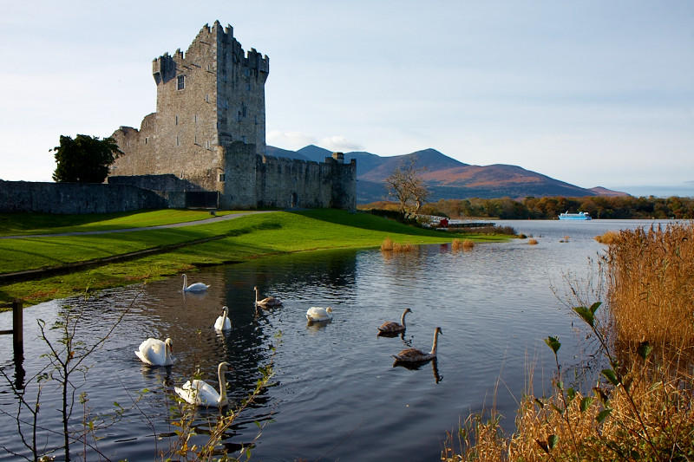
The lands of the rebels were confiscated and granted to ‘undertakers’ loyal to the English crown.
Sir Valentine Browne was granted the lands of O’Donoghue Mór of Ross, near Killarney. For almost 400 years the Browne family held these lands.
Ross Castle, Killarney

Slide 5
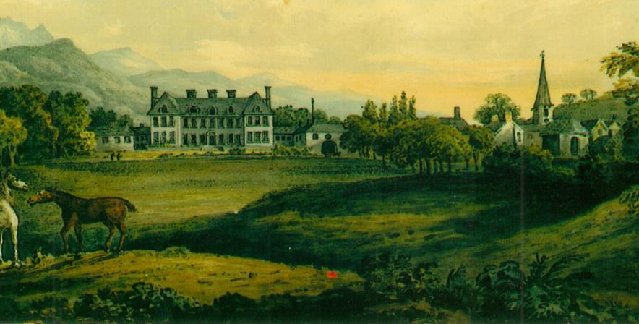
Killarney Town
Stable block
↓
Late 18th century view of Killarney House
One of Sir Valentine Browne’s descendants built a new house, called Killarney House, near Killarney town c. 1725. This view of the house would have looked towards the Countess Road.
The house was demolished in the late 1870s.
After 1913 the old eighteenth century stable block was converted into another house, now also known as Killarney House. (See the red arrow)

Slide 6
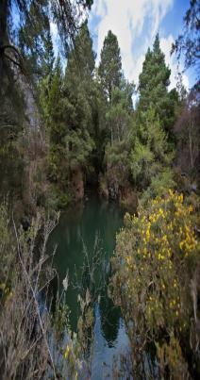
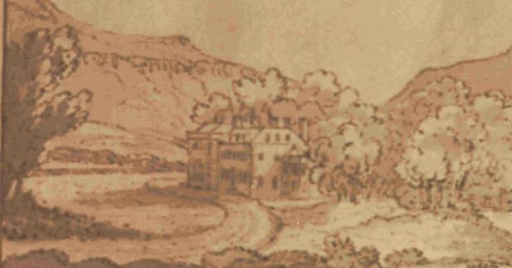
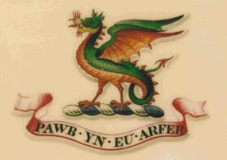
Herbert crest of Wyvern or dragon with the motto:
‘Every man according to his taste.’
The ‘Blue Hole’ open-cut mine, Ross Island.
The ‘Blue Hole’ – open-cut mine, on Ross Island
The first member of the Herbert family to settle in County Kerry was Thomas Herbert, from Wales. He lived near Castleisland.
Thomas’s son Edward may have been the first Herbert to settle at Muckross, on lands leased from the Irish Mac Carthaigh Mór family.
The Herberts built at least four different houses at Muckross, over a period of almost two centuries.
The picture above shows one of the Herberts’ 18th century houses. It stood near Lough Leane (Lower Lake), north of the present Muckross House.

Slide 7
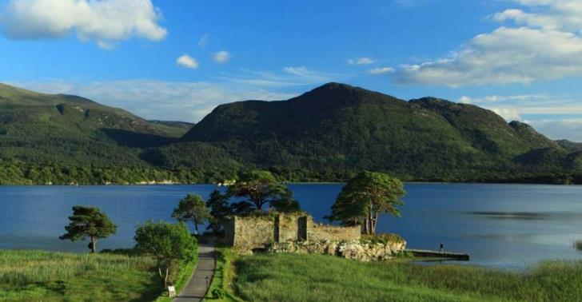
Mac Carthaigh Mór castle at Castlelough, near the Lake Hotel, Killarney..
One of Thomas’ great granddaughters, Agnes Herbert, married Florence Mac Carthaigh Mór and they had one son called Charles.
Charles died when he fell off a horse. His mother’s family, the Herberts, inherited his lands at Muckross, which they had previously only leased.

Slide 8
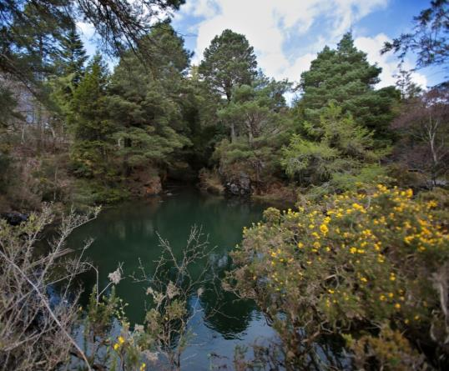
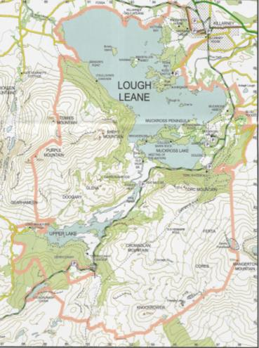
Copper Mines, etc.
$$↓$$
Flooded mine at
Ross Island.
$$↓$$
During the 1750s the Herbert family were involved in copper mining activities on the Muckross Peninsula.
The copper was taken by road to Kenmare and then
shipped to Bristol.
The Herberts were also involved in copper mining on Ross Island during the mid 1750s. However, flooding of the mines by lake water was a problem.
The Herbert family became very wealthy during the 18th
century due to their mining activities.

Slide 9
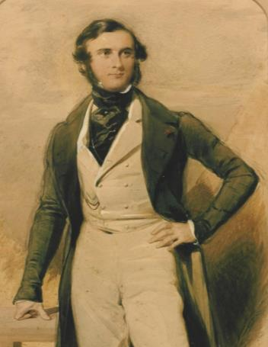
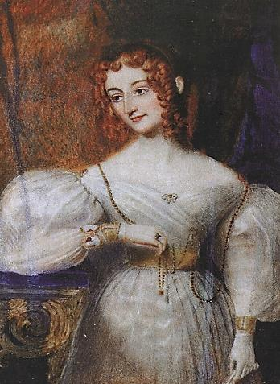
Henry Arthur Herbert (1815-1866) married Mary Balfour in 1837.
He became a Member of Parliament in 1847 and briefly served as Chief Secretary for Ireland 1857-1858.
Mary (1817-1893) was from Scotland.
She loved to paint in watercolours and many of her paintings decorate the walls of Muckross House today.

Slide 10
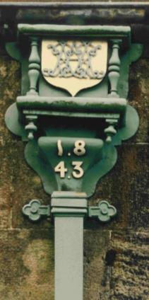
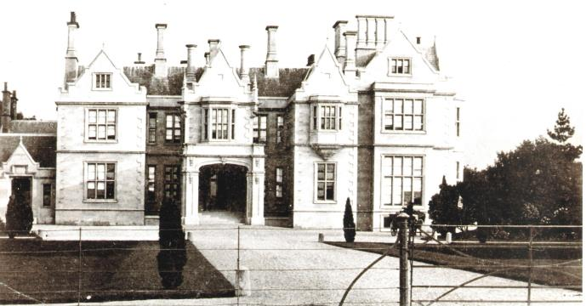
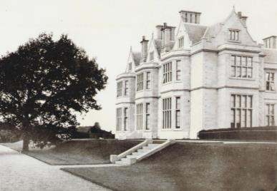
19th century view
Muckross House was completed in 1843 for Henry Arthur Herbert and his wife Mary.
It was designed by the Scottish architect William Burn. He was famous for his Victorian country house designs.
Muckross House was built in the Elizabethan style, of imported Portland stone.
19th century view

Slide 11
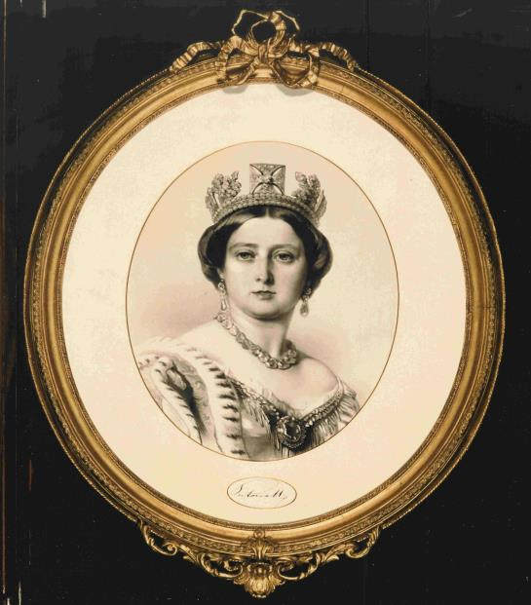
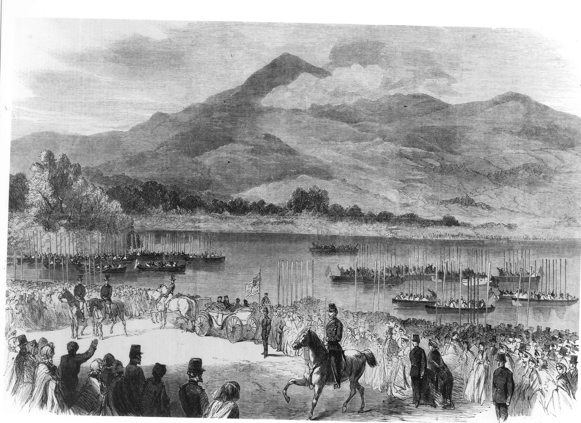
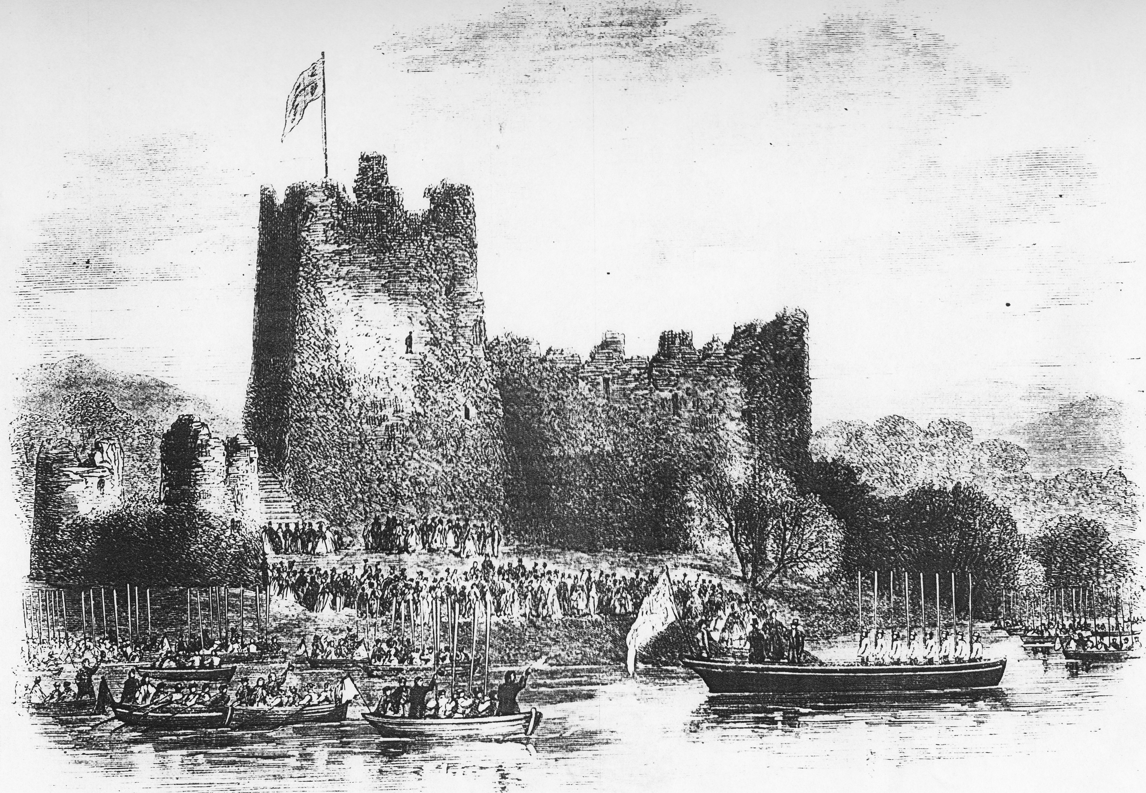
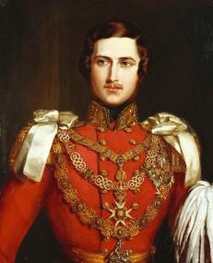
Queen Victoria was only 18 years of age when she became Queen.
She married her cousin Albert, who was a German Prince when she was 21 years old.
They had 9 children and 40 grandchildren.
The Queen embarking upon the lakes at Ross Castle, Tuesday 27 August 1861.
From: Illustrated London News, 1861.
Victoria (1819-1901), became Queen in 1837.
Prince Albert

Slide 12
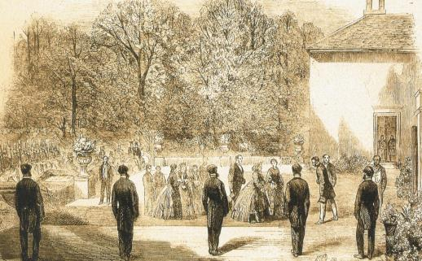
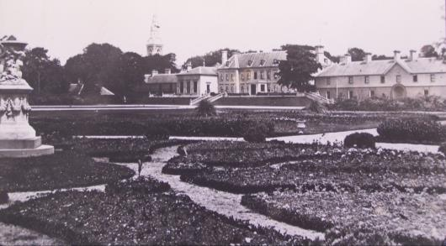
Queen Victoria arrived in Killarney, by train from Dublin, on Monday evening, 26 August 1861.
That night the Queen was a guest of the Browne family (known as Lord and Lady Castlerosse) at their home, Killarney House. This formed the public part of the Queen’s visit.
The photo at bottom left shows the lakeside view of Killarney House (demolished late 1870s) with its stable block (right).
Today, the stable block is known as Killarney House.
Notice the garden with lots of flowerbeds, which would have contained many colourful flowers.
Queen Victoria arriving at Killarney House, 26 August, 1861.
Killarney House ↓
Stable block ↓
Ornate Victorian gardens to rear (lakeside) of Killarney House, c. early 1870s.

Slide 13
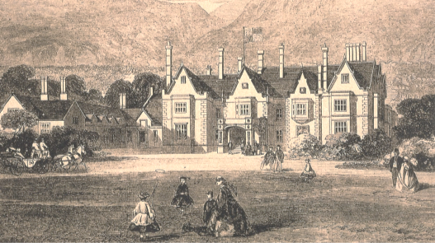
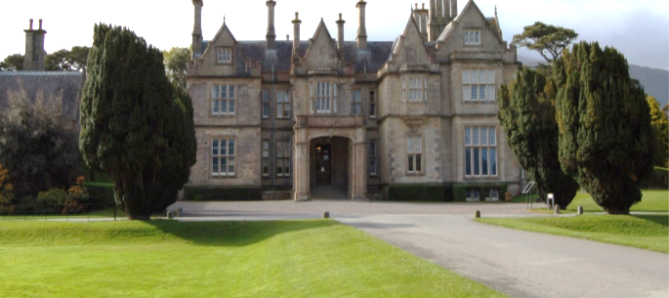
The Queen spent the following two nights (27 and 28 August 1861) quietly as a guest of the Herbert family at Muckross House.
At mid-day on Thursday 29 August she left Muckross and travelled by train back to Dublin.
Above: Muckross House depicted a few days before the Queen’s visit in August 1861.
Watercolour of Muckross Abbey,
painted by Mary Herbert, in 1861.
(Built c. 1448).
Muckross House today.

Slide 14
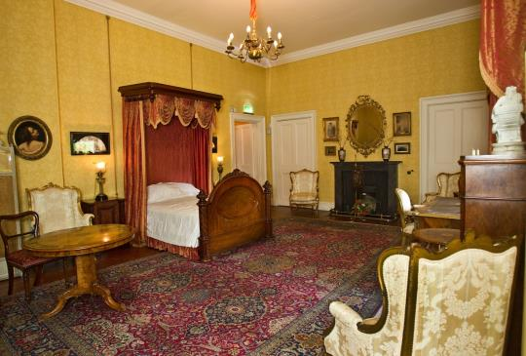
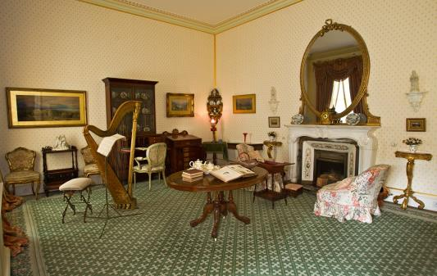
This is the bedroom, which was occupied by the Queen during her visit to Muckross House in 1861.
Many years later, the famous poet William Butler Yeats also stayed here during the mid 1920s.
The Boudoir was the sitting room used by the lady of the house, Mary Herbert.
The Boudoir was also one of the rooms used by Queen Victoria while she was a guest of the Herbert family at Muckross House.

Slide 15
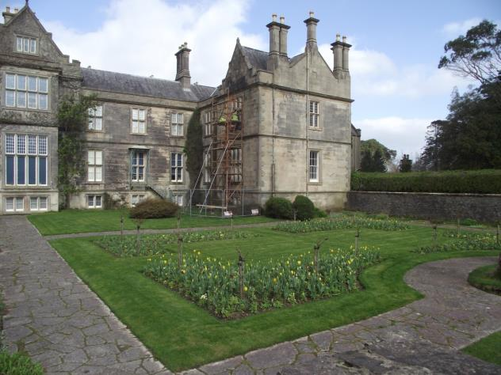
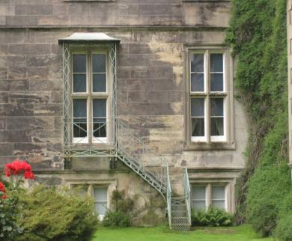
Fire Escape
↓
View of fire escape, which leads from the Boudoir.
A fire escape leads from the Boudoir down into the Sunken Garden.
The Boudoir was one of the suite of rooms used by Queen Victoria during her visit to Muckross in August 1861.

Slide 16
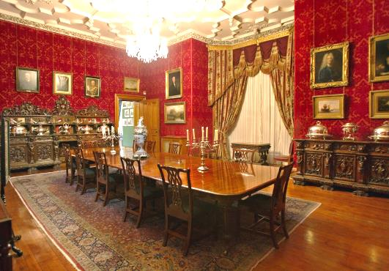
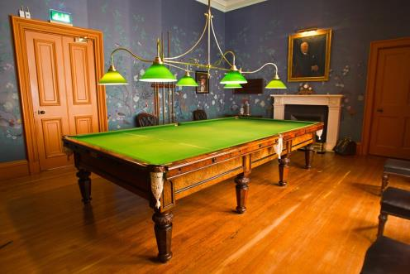
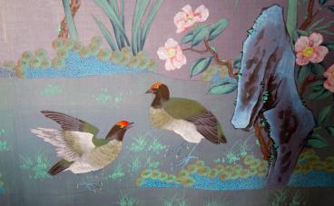
A formal dinner was held each evening for the Queen and the royal family in the Dining-room of Muckross House.
In contrast, the royal family dined by themselves at lunch time each day in the Billiard room of Muckross House.
The walls of the Billiard room were covered with a pretty wall paper for the royal visit.

Slide 17
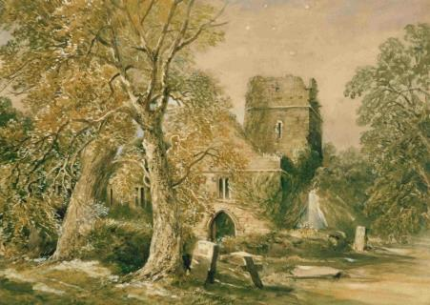
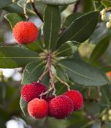
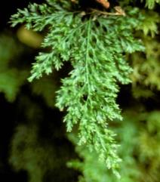
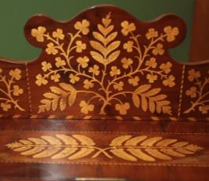
Built c. 1448.
This watercolour of Muckross Abbey, was painted by Mary Herbert of Muckross, in 1861. It hangs in the Queen’s Bedroom at Muckross House.
On the morning of her departure from Muckross, the Queen spent some time visiting the abbey. She requested ivy and ferns to be collected from there and sent to her home at Osborne on the Isle of Wight.
The Victorians loved to collect ferns, but over-collecting threatened some rarer species with extinction.
The Killarney Fern is very rare and is highly protected. It was often depicted on 19th century inlaid wooden furniture made in Killarney.
There are examples of this furniture, made from arbutus, holly, sycamore and yew, in Muckross House.
Arbutus
Killarney Fern

Slide 18
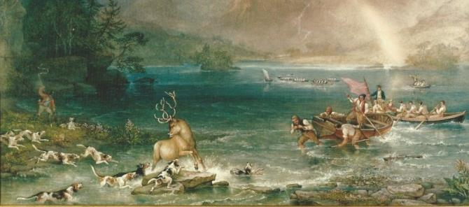
It was once the custom to organise stag hunts upon Killarney’s lakes.
The stag was hunted down from the mountains by men and hounds until it was driven into the water.
It was usually captured in the water by means of a rope around its antlers. Afterwards the stag was usually set free.
This painting of a Killarney Stag Hunt hangs in the Drawing room of Muckross House.
The Herberts organised a Stag Hunt to entertain the Queen when she was their guest at Muckross. It was not a great success as the Queen had left the lake before the stag was eventually captured.
Left: Notice the men pulling hard on their oars.
One man stands in the prow of the boat tying to throw the rope around the deer’s antlers.
Can you spot the hounds in the water?
Killarney Stag Hunt, August 1856.

Slide 19
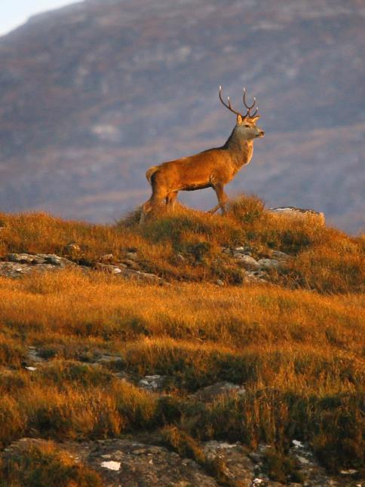
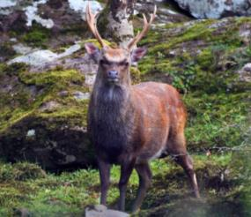
Deer stalking became fashionable among wealthy estate owners during the second half of the 19th century. The Queen’s husband, Prince Albert, made the sport popular.
The development of the rifle allowed deer to be shot over long distances. Deer heads were often mounted on the walls of Victorian houses as at Muckross.
The Red Deer is native to Killarney. The smaller Japanese Sika Deer were introduced in 1865.
Sika Stag
Native Red Deer Stag in Killarney National Park.

Slide 20
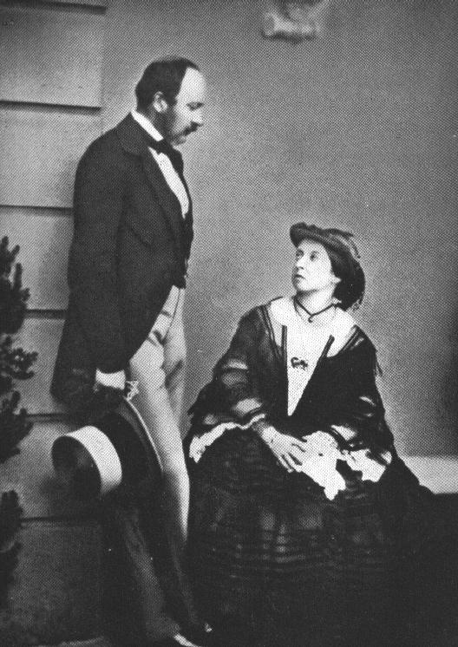
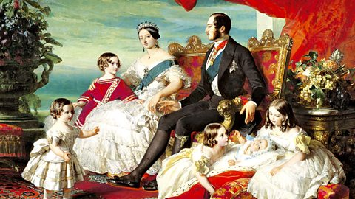
The Queen was accompanied on her visit to Killarney by her husband Prince Albert and four of their children.
In December 1861, just over three months after leaving Muckross, Prince Albert died and the heart-broken Queen went into deep mourning.
Queen Victoria and her husband Albert
in 1860.
The Queen and Prince Albert with some of their children.

Slide 21
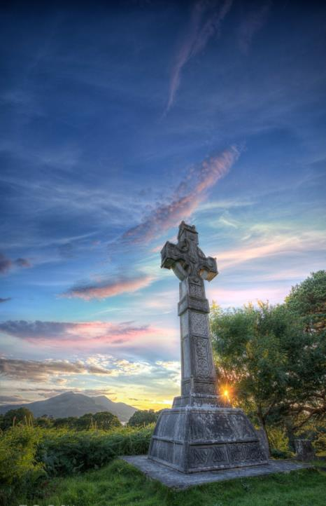
Sadly Henry Arthur Herbert of Muckross died in 1866, just a few years after the royal visit.
Shorty after, the tenant farmers on the Muckross Estate erected this large cross in his memory at the nearby graveyard of Killegy. It overlooks Muckross.
Many of the local tenant farmers were grateful to Henry Arthur Herbert as he had provided them with much assistance during the years of the Great Famine.
This watercolour of the Herbert memorial cross hangs in the Boudoir of Muckross House.

Slide 22
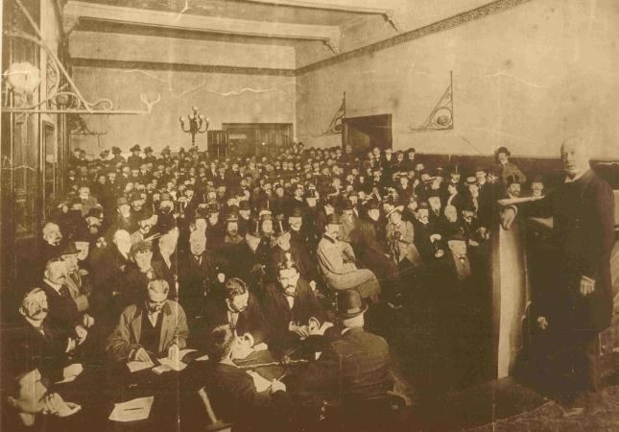
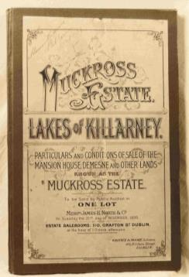
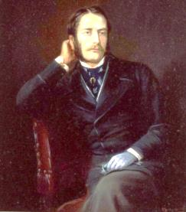
The auction room for the sale of the Muckross Estate,
21 November 1899.
Henry Arthur Herbert’s son, known as Harry, inherited the Muckross Estate. Gradually he fell into debt and he was forced to give up Muckross in 1898.
In November 1899 Muckross was put up for sale by auction but it failed to sell. Shortly after it was bought by Lord Ardilaun of the Guinness brewing family.
Lord Ardilaun

Slide 23
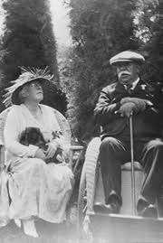
William Bowers Bourn was born in 1857 in San Francisco . He became very wealthy as he owned the Empire gold mine as well as gas, electricity and water companies.
William was married to Agnes Moody and they had one child called Maud.
The family travelled a lot. While they were on board ship travelling to Europe in 1906 Maud met her future husband, Arthur Rose Vincent, from County Clare.
Maud and Arthur were married in California in 1910.
William and Agnes bought Muckross from Lord Ardilaun in 1911 as a wedding present for Maud.
Over the following two decades William financially supported developments at Muckross.
William and Agnes Bowers Bourn.

Slide 24
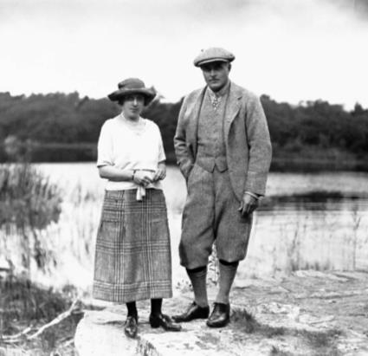
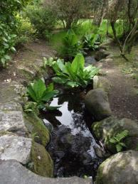
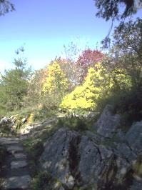
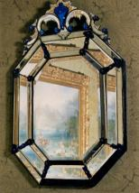
Maud and Arthur at Muckross
Arthur Rose Vincent had worked as a judge in many countries including Thailand, China and Korea. He retired from this work following his marriage.
Like his father-in-law William, Arthur was very interested in developing the beautiful Muckross gardens.
At Muckross they developed the Rock Garden and Stream Garden and redesigned the Sunken Garden.
They also grew vines, peaches and figs in the new Muckross glasshouses.
Maud personally visited the cottages on the estate at least once a year to make sure their employees enjoyed good living conditions.
Stream Garden
Rock Garden

Slide 25
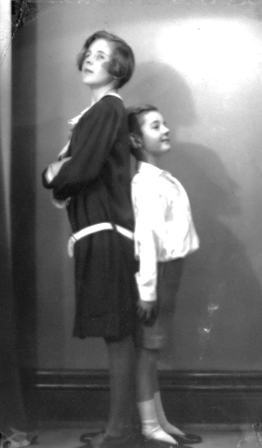
Rosie and Billy at Muckross, early 1920s.
Maud and Arthur had two children.
Elizabeth Rose (Rosie) and Arthur William (Billy).
Although they travelled a lot, Muckross was the childrens’ home.
Rosie 1915-1981.
Billy 1919-2012

Slide 26
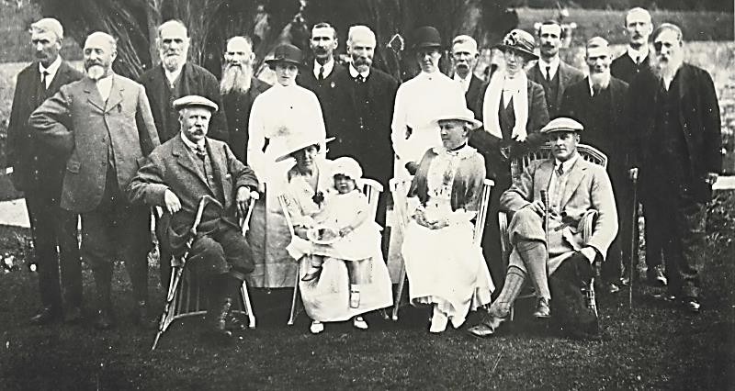
Muckross,
18 July 1916.
↓
William Bowers Bourn
Maud with daughter Rosie
Arthur Rose Vincent
Agnes Bowers Bourn
William
Bowers Bourn
This photograph shows Rosie on her mother’s lap together with her father and grandparents William and Agnes (all seated).
The estate employees have just presented Rosie with a silver tray to welcome her to Muckross for the first time. She was born in London and travel would have been difficult because of the First World War.
The Muckross employees were well treated. Housing conditions were good and they could buy butter, potatoes, milk and vegetables cheaply on the estate. Malnutrition and rickets were eliminated among the estate children.
Arthur Rose Vincent
Maud with daughter Rosie
Agnes Bowers Bourn

Slide 27
W. B. Yeats at Muckross.
John McCormack
The famous Irish tenor, John McCormack, was a guest at Muckross in 1924.
The poet William Butler Yeats was also a guest in 1925 and again in 1926.
Maud was very fond of poetry and she was a very good pianist. She practiced every day in the Drawing room.

Slide 28
Filoli House, California.
Brickeen Bridge
Rosie and Billy in the Sunken Garden.
William Bowers Bourn suffered a severe stroke in 1921 and was unable to travel to Ireland again.
He asked the artist Ernest Peixotto to paint scenes from Muckross on the walls of Filoli ballroom.
William’s two grandchildren Rosie and Billy were painted playing in the Sunken Garden.
Filoli Ballroom with murals of Muckross Abbey and of Brickeen Bridge.

Slide 29
Graveyard at Filoli
Memorial to Maud in graveyard at Filoli.
Memorial to Maud’s daughter Rosie in graveyard at Filoli.
With William in poor health, Maud, Arthur and their children, spent much of the 1920s travelling backwards and forwards between California and Muckross.
In February 1929, Maud became ill while travelling aboard ship from Europe to America. She died shortly after the ship docked in New York and her body was taken to Filoli for burial.
William was devastated following Maud’s death. He decided he could no longer financially support Muckross.

Slide 30
uckross House in Black and white
Saving the hay at Muckross.
Dr Frank Hilliard
William and Agnes, together with their son-in-law Arthur Rose Vincent, decided to present Muckross House and its Estate to the Irish Nation in memory of Maud.
It became the property of the State on 1 January 1933 and was called the Bourn Vincent Memorial Park. However, the House remained empty and forlorn for over 30 years.
In 1964 a local man, Dr Frank Hilliard, suggested that the House should become a Folk Museum for County Kerry.

Slide 31
Dr Hilliard
Muckross House opened to the public on 14 June 1964.
Local schoolgirls were recruited as guides.
About 5,000 people were present for the opening.
Over that first summer in 1964
(c. 16 weeks) 19,000 people visited
Muckross House.
Frank Hilliard and opening

Slide 33
Illustrated London News,
1861.
The morning following her arrival, Tuesday 27 August 1861, the Queen embarked upon the Lake at Ross Castle. There were many people in boats waiting to see her.
She had lunch in a very pretty cottage at Glena and she also visited Derrycunnihy.

